Slide 1
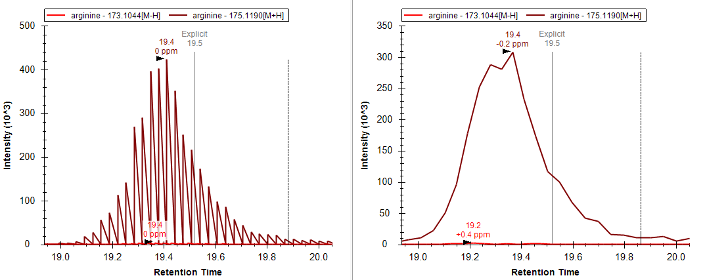
BoxCar
Full scan

