Slide 1
Skyline for Small Molecules, a Sneak Peek at Emerging Capabilities
Brian Pratt, Laura G. Dubois, and J. Will Thompson

Slide 2
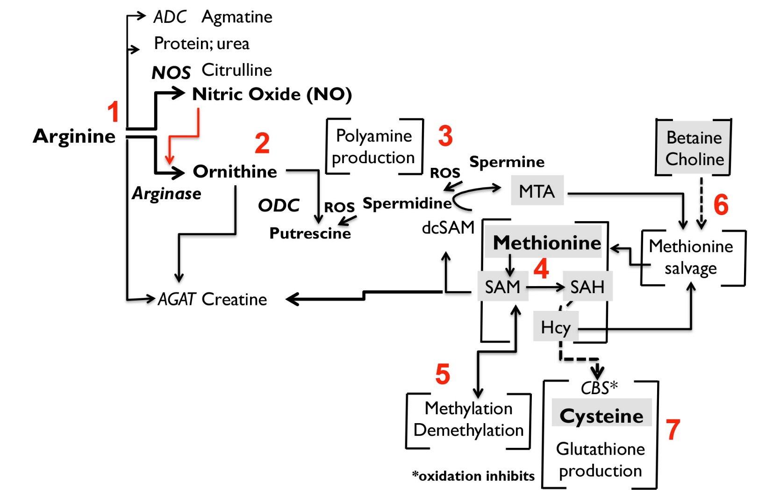
Targeting a Metabolite Pathway of Interest: Arginine and Methionine
Courtesy of Dr. Carol Colton, Department of Neurology, Duke University Medical Center and
Dr. Ashley Chi, Center for Genomics and Computational Biology, Duke

Slide 3
Targeting a Metabolite Pathway of Interest: Arginine and Methionine
= central stimulus (+/-)
= other metabolites of interest
Courtesy of Dr. Carol Colton, Department of Neurology, Duke University Medical Center and
Dr. Ashley Chi, Center for Genomics and Computational Biology, Duke

Slide 4
Precursor and Product Ion Calculations
Experimental Data
Fragmentation Databases
Metlin
MassBank
NIST
In-silico
Currently flat-file support for transition lists, including:
Precursor and product m/z
Retention time
Ion Mobility Drift Time
Future Support for fragmentation libraries
http://metlin.scripps.edu/

Slide 5
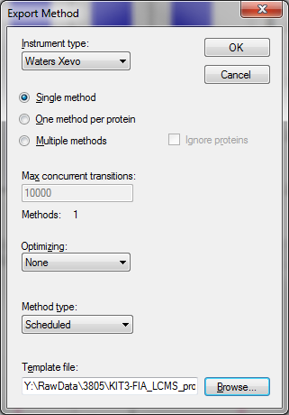
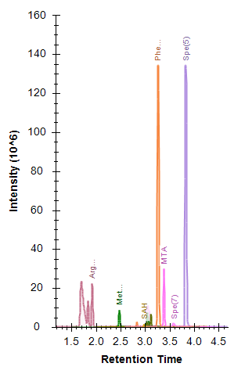
Skyline Small Molecule Workflow Summary
Flat File “Library”
Skyline Document
Export Transition
List/Method
Import and Integrate Raw Data

Slide 6
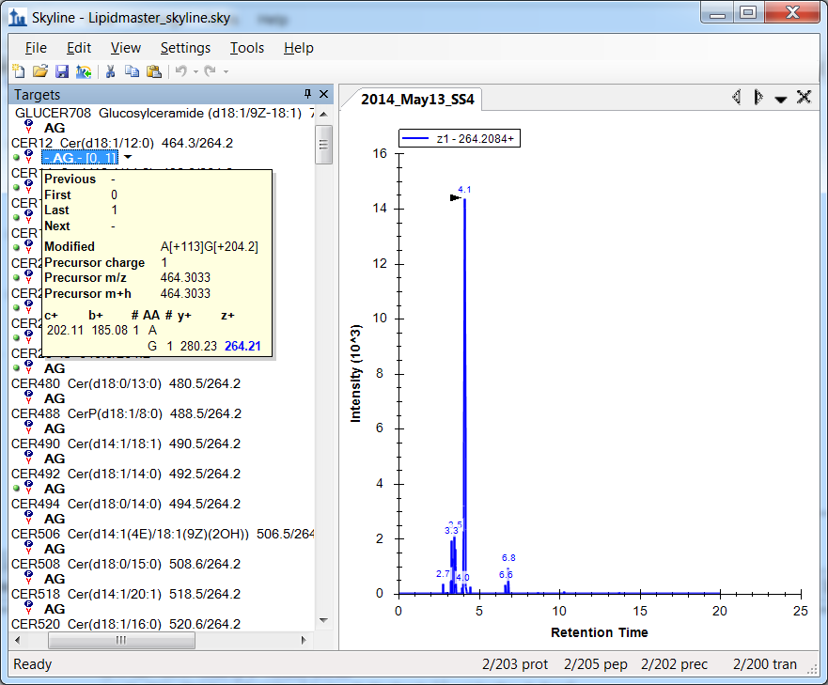
Small Molecules in Previous Skyline Versions
It was always possible to trick Skyline into creating the masses you needed for lipidomics or metabolomics by means of clever peptide modifications, but this was inconvenient and lacked support for negative ions. The Skyline document pictured here was prepared using a previous version of Skyline for a lipidomics experiment by Hari Nair of the Hoofnagle lab at the University of Washington. Constructing this document was a lot of work!
Using Skyline for Targeted Lipidomics is a presentation from the 2013 Skyline User Group meeting in which Andy Hoofnagle (ahoof@u.washington.edu) explains how his group used this approach for practical work.
Recent Skyline-daily versions would greatly simplify this experiment today.

